Slide 1
Gravitational Wave Hotspots: Determining Probable Locations For Single Source Gravitational Wave Emission
Joseph Simon
Collaborators:
Andrea Lommen, Franklin & Marshall College
Ben Stappers, University of Manchester
Sam Finn, The Penn State University
Rick Jenet, University of Texas at Brownsville
Abigail Polin, New York University

Slide 2
Compiled ~70,000 extragalactic sources
From Tully Extragalactic Distance Database
All sources are within ~150 Mpc
Luminosity was used as a surrogate for central black hole mass
Basic Assumptions
Every galaxy has an equal chance of containing a SMBH binary
Binaries are approximately equal-mass
Every binary orbit has the same period

Slide 3
Galaxy Distribution (Number Density)
Virgo Cluster
Plane Of Milky Way Galaxy

Slide 4
Galaxy Distribution [Each Pixel = Σ (distance to source)⁻¹]
Virgo Cluster
Fornax Cluster

Slide 5
Integrated GW Power Statistic
GW Strain
Lifetime Of Source
Integrated GW Power

Slide 6
Galaxy Distribution [Each Pixel = Σ (τ₁ + τ₂ + …)]
Coma Cluster
Virgo Cluster
Fornax Cluster

Slide 7
Integrated GW Power
Coma Cluster
Virgo Cluster
Fornax Cluster

Slide 8
Histograms Of Galactic Statistics
h Statistic
p Statistic
Case A
10 sources
Case B
100 sources
Case C
1000 sources

Slide 9
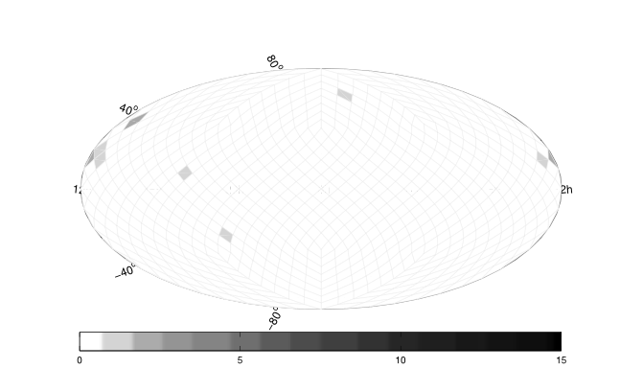
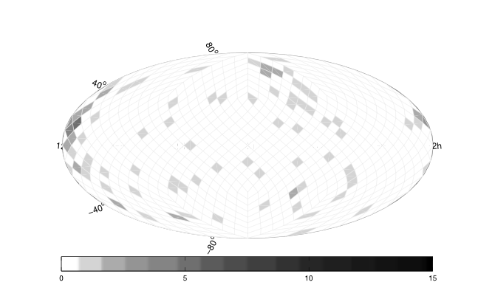
Location Of Probable Sources Based On PTA Sensitivity To h
Coma Cluster
Virgo Cluster
Fornax Cluster
Case A
Case B

Slide 10
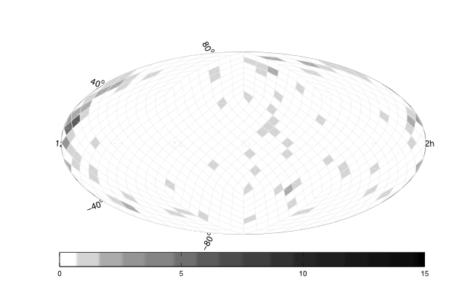
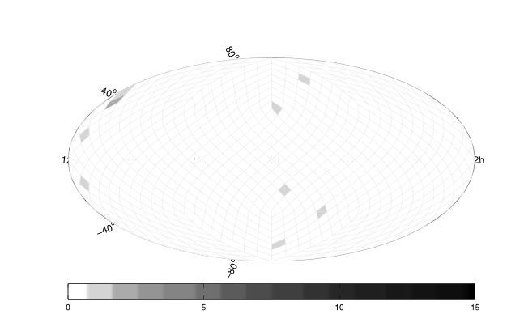
Location Of Probable Sources Based On PTA Sensitivity To p
Coma Cluster
Virgo Cluster
Fornax Cluster
Case A
Case B

Slide 11
Probability Conclusions
 | Virgo | Coma | Fornax | Average
Case A - h | 0.02% | 95.5% | 0% | 0.1%
Case A - p | 0.2% | 0.06% | 0.08% | 0.18%
Case B - h | 0.21% | 1.5% | 20.5% | 0.24%
Case B - p | 0.3% | 0.03% | 0.42% | 0.06%
Case C - h | 1% | 0.22% | 1.56% | 0.05%
Case C - p | 0.65% | 0.01% | 0.33% | 0.01%

Slide 12
Overall Conclusions
Local Universe Is NON-ISOTROPIC
“Hotspots” Occur In Close Galaxy Clusters
Virgo Cluster
Consistently significant zone of the sky
Coma Cluster
High potential to catch bright and long sources
Fornax Cluster
Probability dramatically improves with sensitivity
Implications For Optimizing PTAs
Increase Sensitivity In Directions Of Clusters

